Slide 1
Building a modular autonomous race car

Slide 2
Contents
FSG Rules 2021 & 2022
Season 2017/2018
URE14 Concept
Challenges
Current Status

Slide 3
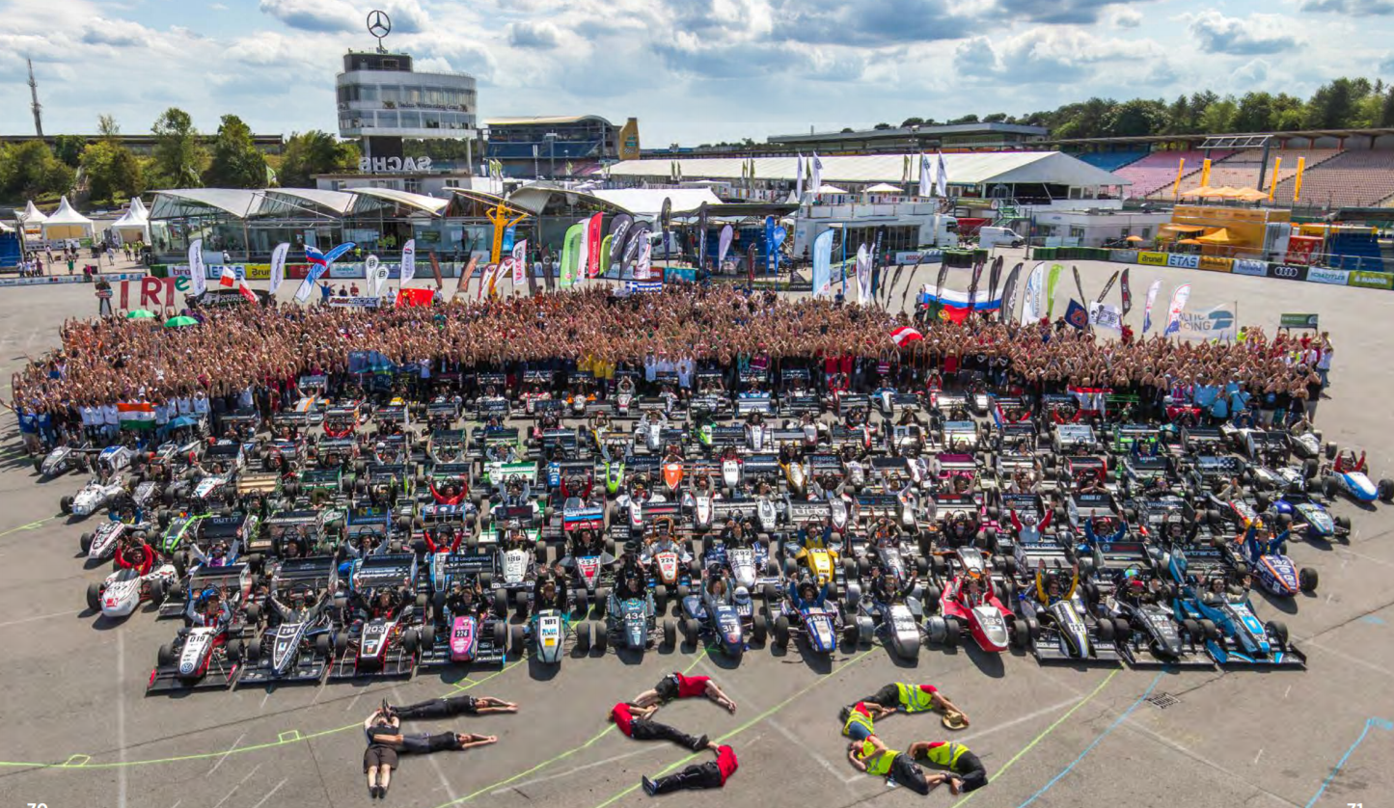
FSG Rules 2021 & 2022
Merging FSD with FSE/FSC
Driverless Acceleration event
Driverless Skidpad event

Slide 4
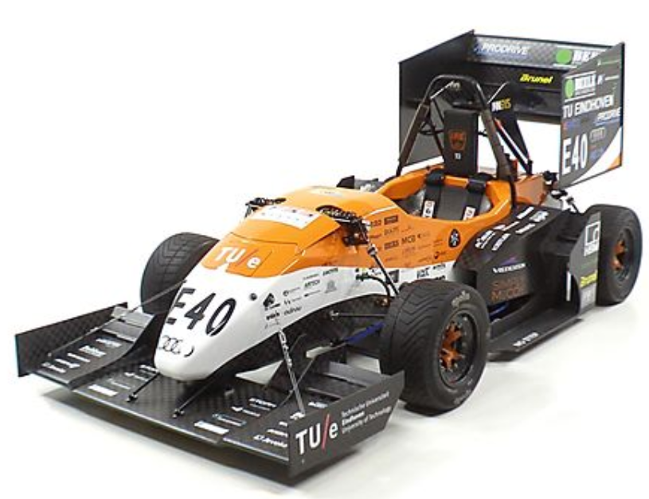
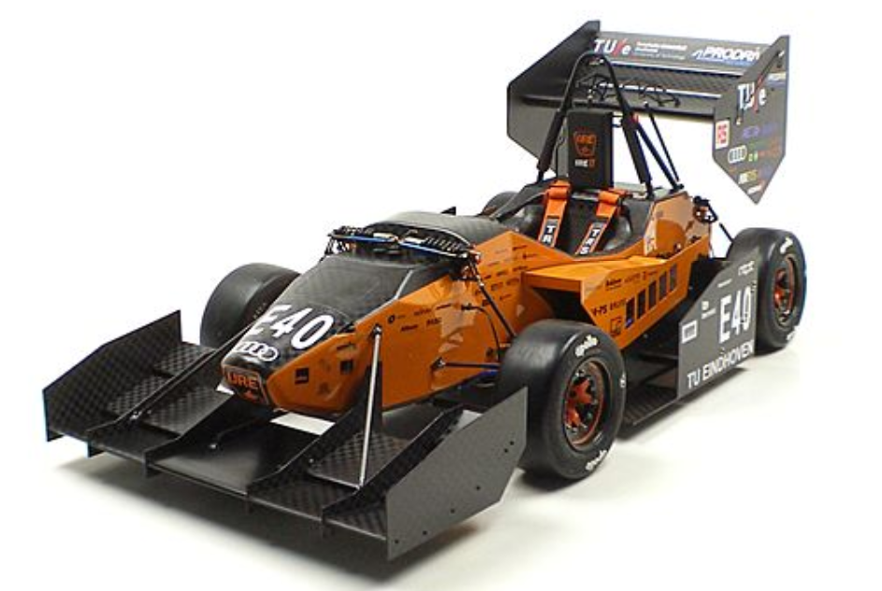
Season 2017/2018
URE13
URE11d
Team focus
Priorities

Slide 5
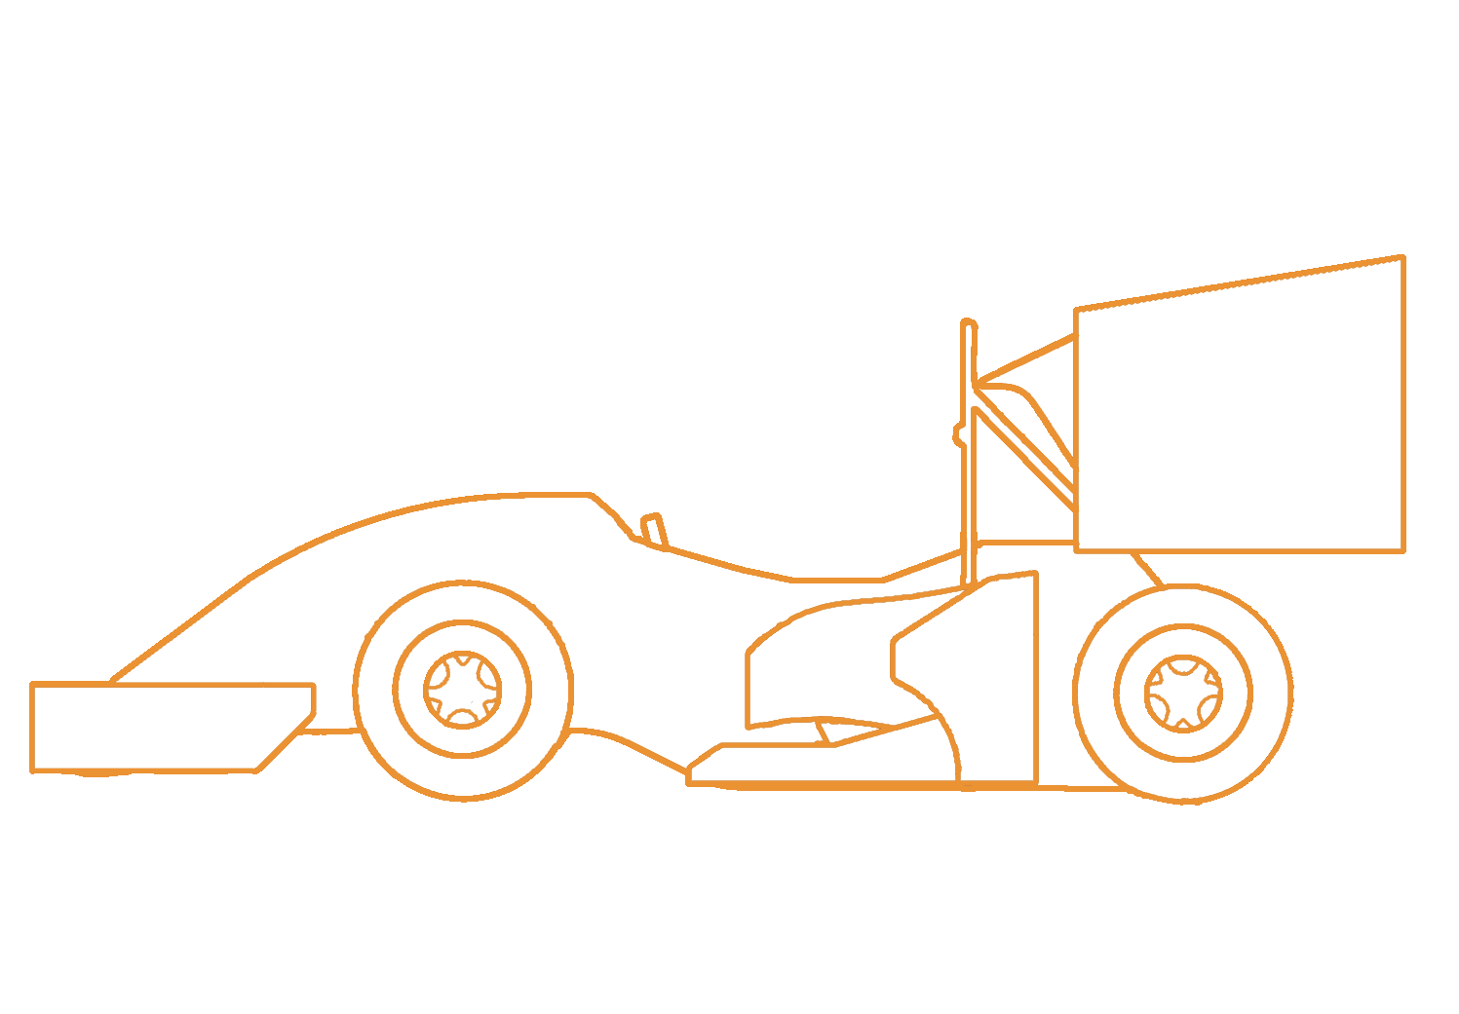
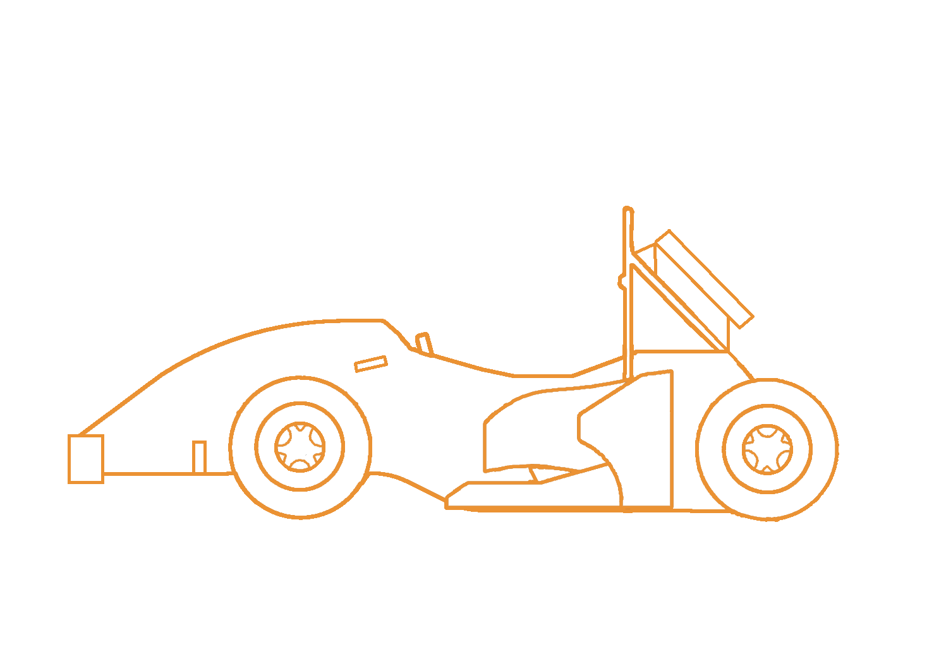
URE14 Concept
Electric class
Driverless class
One team, one car
Modular
Unique

Slide 6
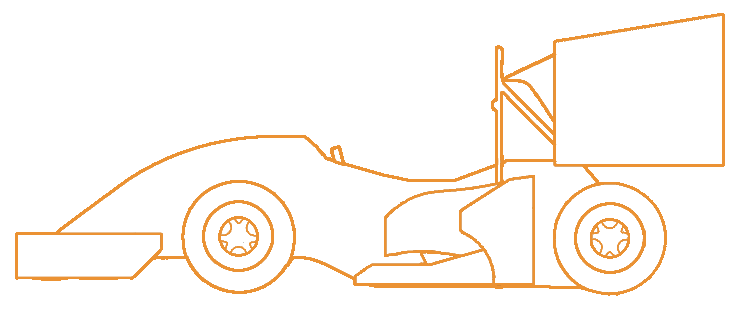
URE14 Concept
IBEO Lux LiDAR
Mono Cameras
Nvidia Drive PX2
Steering Actuator
Brake Actuator
RES Receiver
Front Wing
Rear Wing
Wiring Harness
Undertray
DV
EV
DV+EV

Slide 7
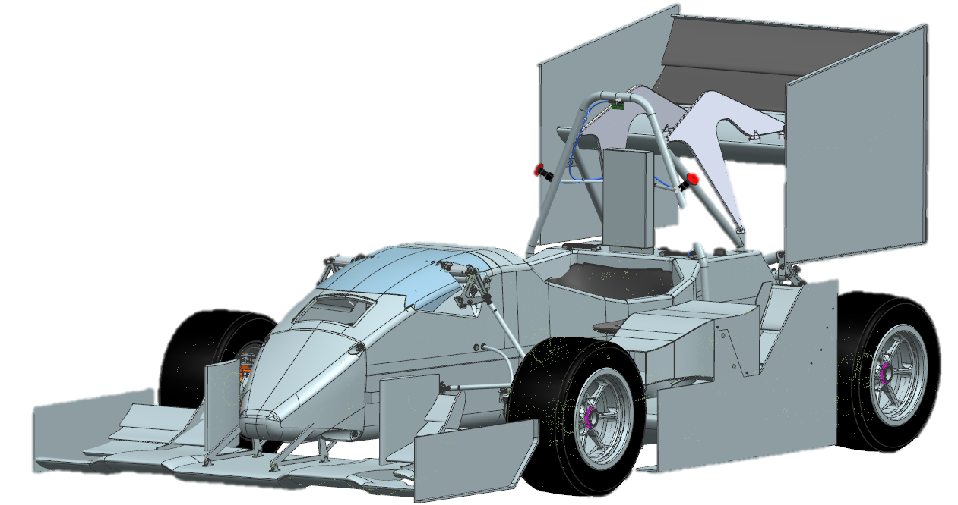

Slide 8
Challenges
Packaging
Wiring harness
Power supply
Weight
Scrutineering
Simultaneous Development

Slide 9
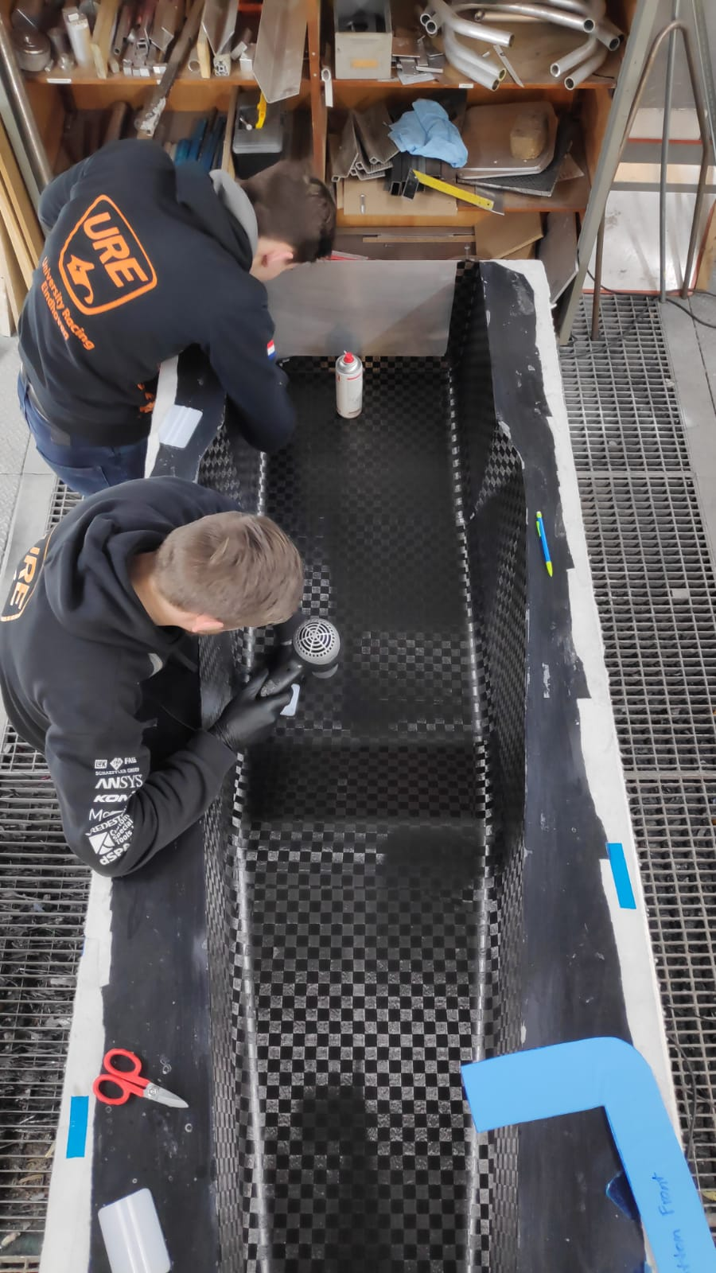
Current Status
Autonomous URE11d
URE14 in production
Dual purpose autonomous
brake system in production
Software integration

Slide 10
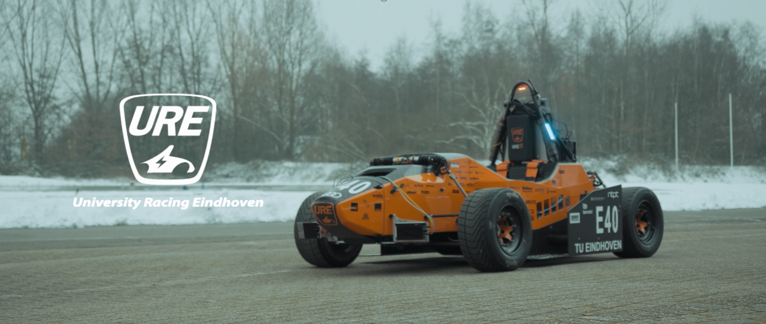

Slide 11
Thank you!

